Slide 1
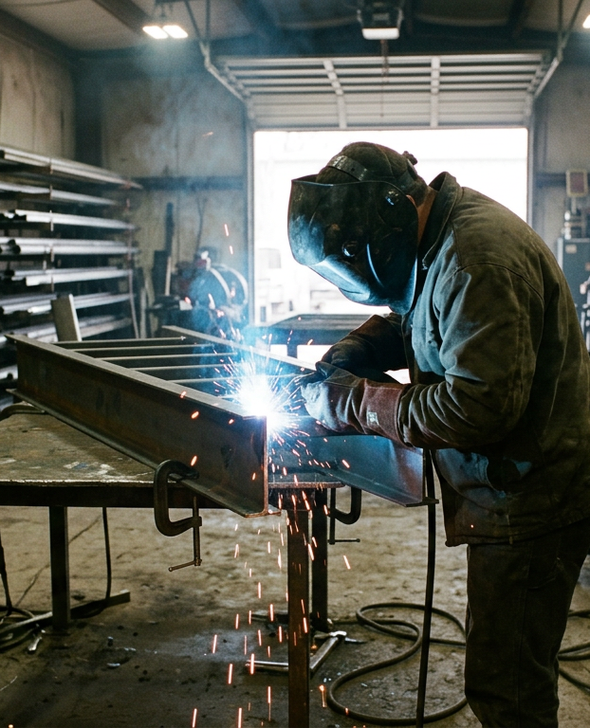
LOAN REQUEST · LENDER MEETING
Tollgate Metalworks
A second bay and a CNC plasma table
$185,000 SBA 7(a) term loan · 10 years
Example business (fictional) · sample deck prepared by Acrid Team
Notes:
Open with the one sentence: we are asking for $185,000 to add a second bay and a CNC plasma table, because last year we turned away $142,000 of quoted work for lack of capacity.

Slide 2
The ask, on one slide
$185,000
What it buys
A 5x10 CNC plasma table, a second bay with its own door and a 2-ton crane. Cutting that takes a welder hours takes the table minutes, and a trailer in one bay no longer stops stair work in the other.
SBA 7(a) term loan, 10 years
Owner injection: $25,000 (12% of the $210,000 project)
Collateral: the equipment it buys, existing equipment, and both owners' guarantees
What it returns
Projected 2026 revenue of $935,000 (+$154,000), from 60% of the work declined last year plus faster turns on existing jobs. No price increases assumed.
Why now: we declined $142,000 of quoted work in 2025 because one bay and hand cutting could not get to it. The second bay and the table remove both limits.
How it is repaid
From operating cash flow. The new payment is covered 1.9x in year one and 1.3x if revenue falls 15%. Break-even with the payment is about 83% of 2025 revenue.
Tollgate Metalworks · example business (fictional) · loan request
2
Notes:
Everything else in the deck supports this slide. If there is only time for one, this is it.

Slide 3
Eleven years of steel, seven people, one bay
2015
Founded by two partners. Still owner-operated, both on the floor every day.
2025 revenue by customer type
7
Employees, four of them certified welders. One office manager, one apprentice.
3,200
Square feet of shop. One bay, one 12-foot door, one hand plasma cutter.
38
Active accounts. 61% of 2025 revenue came from customers who had bought before.
What we make: structural steel for residential builders, custom stairs and railings, trailer and farm-equipment repair, light commercial fit-out.
Tollgate Metalworks · example business (fictional) · loan request
3
Notes:
Lenders want to know the business is stable and the owners are the operators. Point out the repeat rate; it is the best evidence of character we have that isn't a credit score.

Slide 4
Three years of growth, same four walls
Revenue, filed returns ($ thousands)
38%
gross margin, steady three years
10.2%
net margin in 2025 ($79,700 net income)
$142,000
of quoted work declined in 2025 for lack of capacity
Figures from filed returns and the YTD P&L, attached.
Tollgate Metalworks · example business (fictional) · loan request
4
Notes:
Three years of growth with the same footprint is the point. The $142,000 figure is from the quote log: jobs we quoted, won on price, and then lost on lead time.

Slide 5
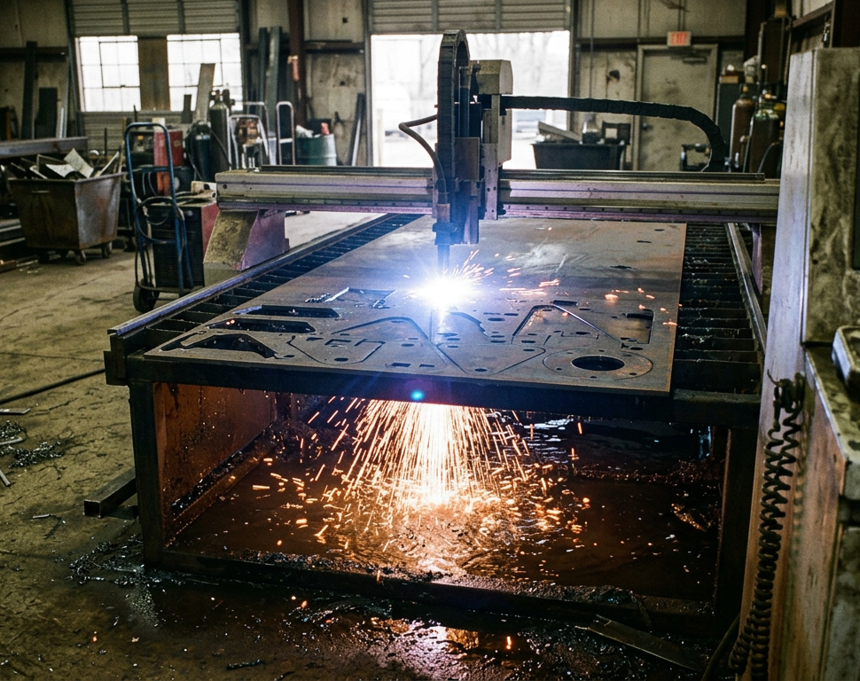
The bottleneck is cutting, and the bay
1
Hand plasma and a grinder
About 11 hours a week of a certified welder's time goes to cutting plate and cleaning edges. The CNC table cuts a full 4x8 sheet of parts in 12 minutes, to within 1/32", with no grinding.
2
Six-week lead time
Larger shops quote two to three. Builders schedule around us when they can and go elsewhere when they can't; that is where the $142,000 went.
3
One bay, one door
When a trailer or a piece of farm equipment is in for repair, stair and railing fabrication stops. A second bay separates repair from fabrication.
The table in the vendor quote: 5x10 water table, torch height control, nesting software. Training for three staff is in the price.
Tollgate Metalworks · example business (fictional) · loan request
5
Notes:
Keep this concrete. The lender does not need to know how plasma works; they need to see that the money buys hours back and lets us take the work we already win.

Slide 6
Use of funds: $210,000, itemized from vendor quotes
Item | Source | Amount
CNC plasma table, 5x10, software, install, training | Vendor quote A (attached) | $74,000
Second bay build-out: slab, 14' door, 3-phase power | Contractor quote (attached) | $58,000
2-ton bridge crane, installed | Vendor quote B (attached) | $26,000
Welding positioner + two MIG machines | Vendor quote C (attached) | $18,000
Working capital, first 90 days (consumables, hire) | Owner estimate | $20,000
Contingency (about 7%) |  | $14,000
Total project |  | $210,000
Funded by
$185,000
SBA 7(a) loan · 88%
$25,000 owner cash · 12%
Timeline
Close by December
Table lead time 8 weeks; build-out 10 weeks, run in parallel
Second bay cutting parts in Q1
Second welder hired month 4
Tollgate Metalworks · example business (fictional) · loan request
6
Notes:
Every line maps to a quote in the appendix. Contingency is there so we never come back for more.

Slide 7
Projections: the conservative case
Revenue with and without the project ($ thousands)
What the 2026 number assumes
+$85,000
60% of the work declined in 2025 comes back. Builders who asked once tend to ask again.
+$69,000
Faster turnaround on existing accounts: 15% more jobs from the same customers.
0%
Price increases assumed. None.
+3 pts
Gross margin from 2027, as cutting labor drops. Not counted in 2026.
Tollgate Metalworks · example business (fictional) · loan request
7
Notes:
Say out loud that the grey bars are what happens if we do nothing: flat, because we are full. The blue bars are built from two numbers we can show in the quote log, not from a market-size slide.

Slide 8
Repayment: covered 1.9x in year one, 1.3x in a bad year
Year | Cash available for debt service | Total debt service | Coverage
2025 actual, as if the loan existed | $58,000 | $36,540 | 1.59x
2026 projected | $71,000 | $36,540 | 1.94x
2027 projected | $84,000 | $36,540 | 2.30x
Stress: 2026 revenue down 15% | $47,500 | $36,540 | 1.30x
Monthly payment
$2,445
$185,000 over 10 years at an assumed 10.0%. Replace with the term-sheet rate; at 9.0% the payment is $2,343, at 11.0% it is $2,548.
Break-even with the new payment
How the rows are built. Cash available = net income + depreciation + interest, after owner salaries at their current level. Total debt service = the new payment ($29,340 a year) plus the existing truck loan ($7,200 a year, 2 years left). The stress row cuts 2026 revenue to $795,000 and holds costs flat; it does not assume we would cut anything, though we could.
$650,000
About 83% of 2025 revenue covers every fixed cost, owner pay and all debt service, before any margin gain from the table.
Most lenders want coverage above 1.25x. Every row clears it.
Tollgate Metalworks · example business (fictional) · loan request
8
Notes:
This is the slide the loan officer will photograph. Walk the rows slowly. The stress row is the one that earns trust.

Slide 9
Collateral, capital, character
Collateral
Capital
Character
• Purchase-money lien on the CNC table and crane ($100,000 new)
• Existing equipment, appraised at $96,000 (list attached)
• Accounts receivable, $61,000 average balance, 34 days
• Personal guarantees from both owners
• $25,000 owner cash into the project
• $112,000 retained in the business over three years
• One truck loan outstanding, $18,400, paid as agreed since 2023
• No other debt, no liens, no judgments
• Eleven years operating, same two owners
• Both owners' personal credit above 720
• 38 active accounts, 61% repeat; builder references on request
• Taxes, payroll and vendors paid on time; statements attached
$257,000
$137,000
11 years
pledged against a $185,000 loan: 1.4x
of the owners' own money in the business
same two owners, nothing paid late
Tollgate Metalworks · example business (fictional) · loan request
9
Notes:
The five Cs, minus conditions, which is the market slide we skipped on purpose: our demand evidence is the quote log, not a forecast.

Slide 10
What could go wrong, and what we do about it
RISK
WHAT WE DO ABOUT IT
Customer concentration
New capacity targets six new builder accounts in 2026; no single account above 15% by 2027.
1
Top account is 22% of revenue.
Steel prices
Quotes valid 30 days; a material pass-through clause in every contract over $10,000.
2
Plate and tube move 10-20% in a year.
Key person
Vendor training for three staff is in the quote; the second welder is certified on it in month one.
3
Only one of us has run a CNC table.
A slow year
Payment covered at 83% of 2025 revenue; a 15% drop still covers debt service 1.3x. Repair work is counter-cyclical and stays in the old bay.
4
Builders pull back when rates rise.
Tollgate Metalworks · example business (fictional) · loan request
10
Notes:
Name the risks before they do. Each mitigation is something already in motion, not a promise.

Slide 11
THE ASK
Attached with this deck
$185,000, ten years, closing by December
✓ Business tax returns, 2023-2025
✓ YTD profit and loss, balance sheet
✓ AR and AP aging
✓ Quote log: jobs declined in 2025
✓ Vendor quotes A, B, C and contractor quote
✓ Lease addendum (LOI) for the second bay
✓ Equipment list with appraisal
✓ Personal financial statements, both owners
✓ Business debt schedule (one truck loan)
Buys a second bay, a CNC plasma table and a crane. Takes the work we already win. Repaid from operating cash flow at 1.9x coverage in year one, 1.3x in a bad one.
Next steps
1. Lender review of the attached package
2. Site visit any weekday; the quote log and job board are on the wall
3. Term sheet; we swap the assumed rate on slide 8 for yours
owner@example.com · Example business (fictional)
Tollgate Metalworks · example business (fictional) · loan request
11
Notes:
End on the ask and the package. Offer the site visit; shops that are proud of the floor get believed.

